Slide 1
Building a Serverless Discord bot in Azure Functions
The PoSh Wolf
https://github.com/theposhwolf/sessions

Slide 2
Who is The PoSh Wolf?
Anthony Howell
From Eugene, OR USA so, according to ChatGPT, I am:
Progressive, outdoorsy, creative, friendly, and open-minded
~3.3 kids, 2 dogs, 1 wife, 1 cat
In IT since 2011
Blogger (https://theposhwolf.com)
Twitter (https://twitter.com/theposhwolf)
Pluralsight author (https://pluralsight.com)
Consulting (https://howell-it.com)
Employed (Cloud Platform Architect)

Slide 3
Fun Fact

Slide 4
Picture

Slide 5
Overview
Purpose and goals
Discord slash command process explanation
Function Chaining
Azure Function workflow
Creating a Discord bot
Avoiding frostbite
The code itself
Command addition process
Notes:
Not covering Game Server stuff, but happy to discuss and share code

Slide 6
Why not PoshBot?

Slide 7
Why?
Background
Money
Electricity is expensive
Azure VMs bill based on consumption
Azure Functions bill based on consumption
Professional Development
Coolness factor

Slide 8
Current Approximate Cost
~$3/mo
Function App - $0.04
Storage Account - $1.72
Application Insights - $1.25 (Optional)

Slide 9
Goals
Discord Bot
Azure Based
Inexpensive
Fast
PowerShell

Slide 10
Prerequisites
PowerShell
Discord Developer account
Azure Subscription
Azure Function Knowledge

Slide 11
Demo Environment
Windows 10
VS Code (latest version)
w/Azure and Azure Function Extensions
PowerShell 7.2 (Azure Function)
Discord.Net.PowerShell
https://github.com/theposhwolf/discord.net.powershell

Slide 12
Discord Slash Commands

Slide 13
Slash command demo…

Slide 14
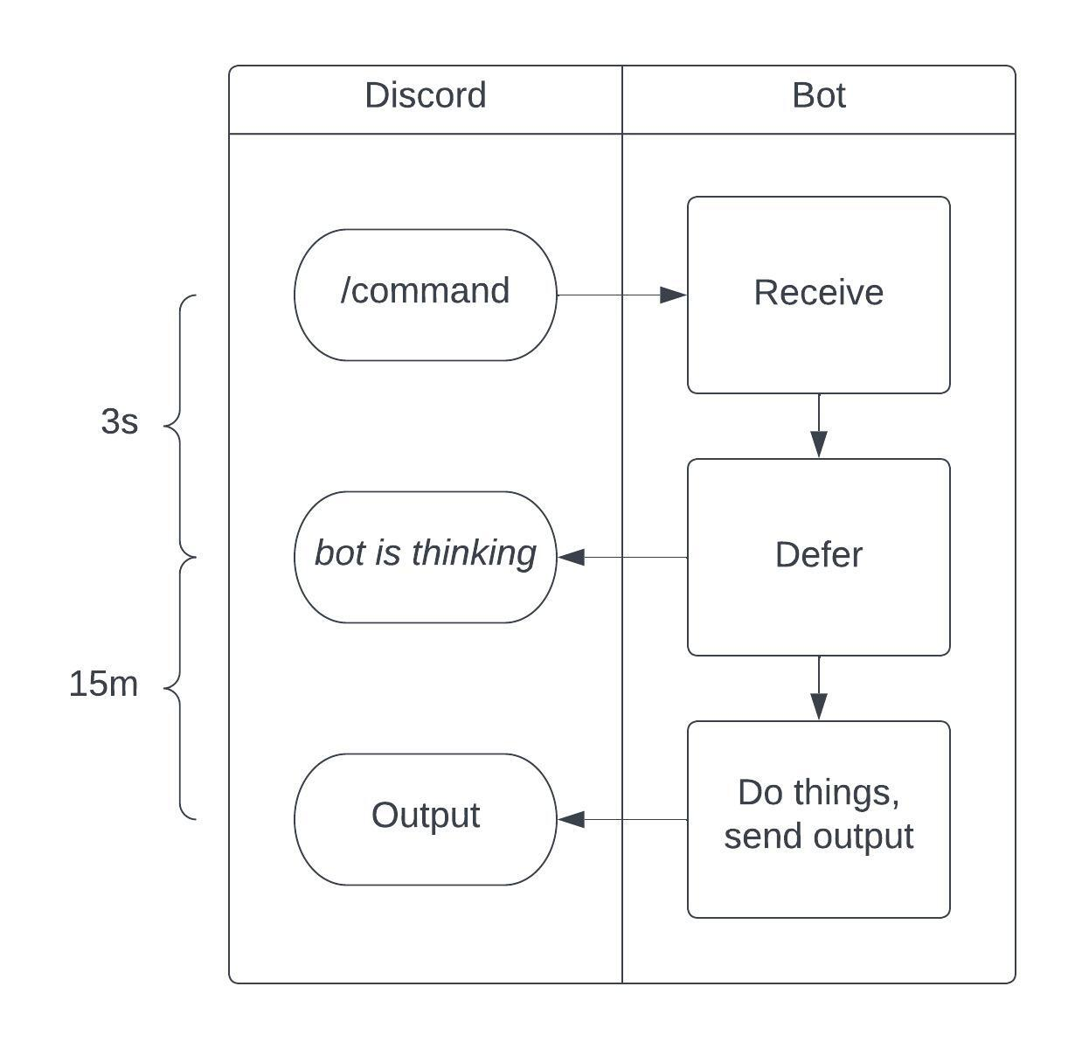

Slide 15
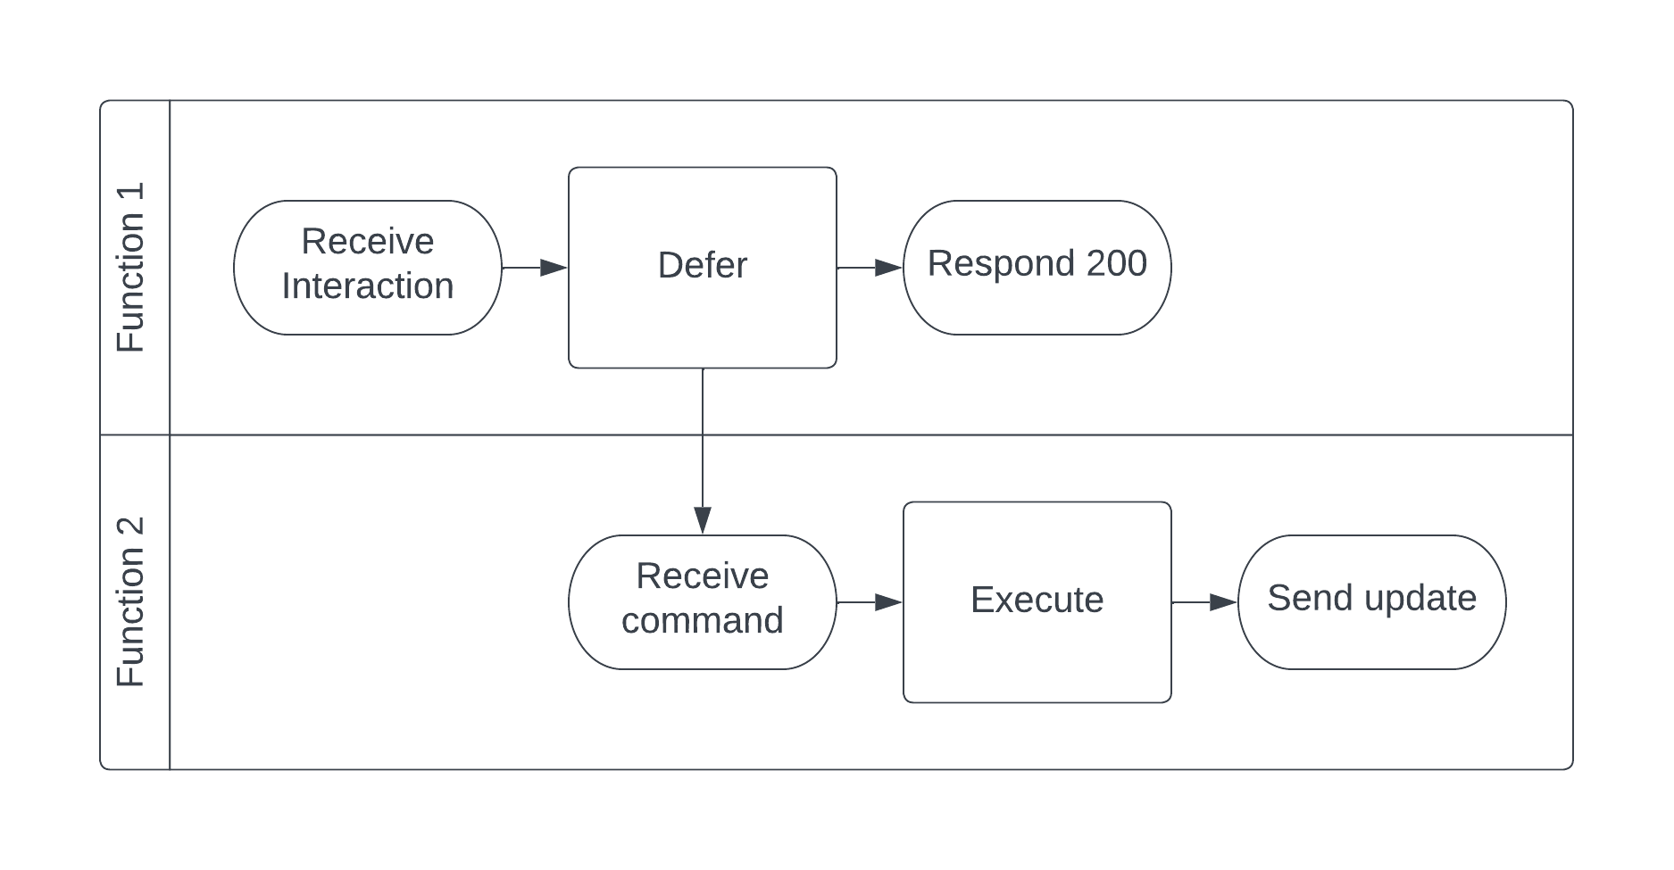
Function Chaining

Slide 16
Function Chaining Evolution

Slide 17
Queue Based
Building a Discord Bot in PowerShell and Azure Functions
Devin Rich
Command is passed off via a queue
Slow

Slide 18
Durable Functions
Command is passed off via New-Orchestration
Very storage intensive (expensive)

Slide 19
HTTP POST Chain
Command is passed off via HTTP POST
Fast, but requires function keys and -TimeoutSec

Slide 20
Azure Function Workflow

Slide 21
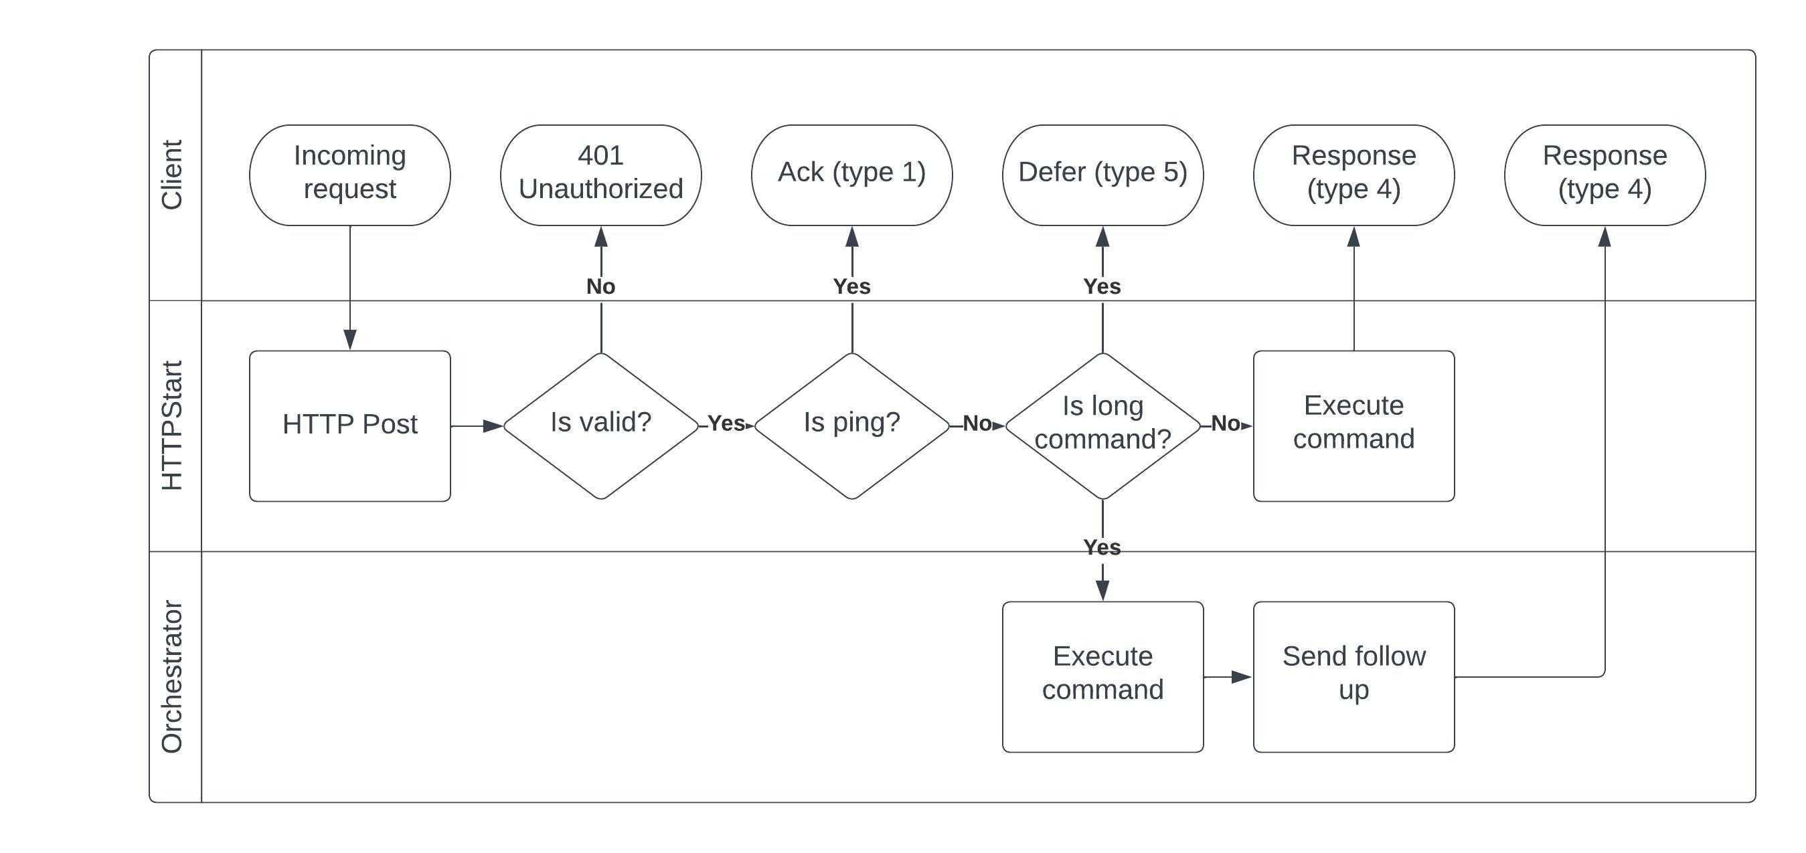

Slide 22
Azure Function code demo…

Slide 23
Creating a Discord Bot
Create Discord App
Bot -> Add bot
Oauth2 -> URL Generator ->
bot
application.commands
bot\send messages
Others as needed (none other needed for this demo)
Add HttpStart URI to Interactions Endpoint URL

Slide 24
Dealing with frostbite
PowerShell based Azure Functions have a long cold start
Monitor Function
Every 5m
Review Code

Slide 25
Full function code review…

Slide 26
Adding Commands

Slide 27
Command Types
Application (Global)
Applies to all servers
Slow propagation
Guild (Server)
Applies to a specific server
Instant propagation

Slide 28
Adding commands demo…

Slide 29
Building the bot yourself
Deploy ’03 – Function App’ folder to an existing Azure Function that is Linux PowerShell 7.2+ using VS Code
Create a bot in Discord, set the bot’s public key as a function app config item called: ‘DISCORD_PUBLIC_KEY’
Make sure the bot is warm and then copy HttpStart function url into the interactions URL for the bot.
Add the bot to a server by creating a URL and then navigating to it.
Create hello guild command
Run: /hello

Slide 30
Questions?

